Slide 1
Ministry of Science and Higher Education of the Russian Federation ITMO University School of Translational Information Technologies
Field of study «01.04.02 Applied Mathematics and Informatics»
Profile: Bioinformatics and Systems Biology 2023
Homework 2 of «Microbial Omics. ITMO. Fall 2024»
“Project - “How humans populated the Earth””
Student of Group №: M4135, Institute of Applied Computer Science
Wong Pei Fong (Вон Пэй Фон)
Lecturer:
Mike Raiko
Saint-Petersburg, 23.10.2024

Slide 2
Workflow
Download human mtDNA data
Merged all FASTA files
Align the merged FASTA file with 45 human mitochondrial genomes
Phylogenetic analysis
Construct Neighbour Joining tree with bootstrap test
Estimate the age of the mitochondrial Eve and most recent ancestor of all non-Africans, build a distance matrix in MEGA.
Add five Neanderthal samples and three Denisovan samples to the set of Homo sapiens samples and construct the resulting evolutionary tree.
Estimate the separation time and branching order of the Neanderthal and Denisovan population.

Slide 3
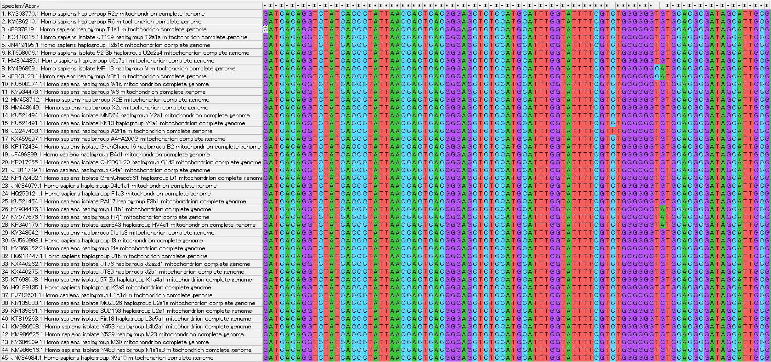
Alignment of 45 human mt genomes

Slide 4
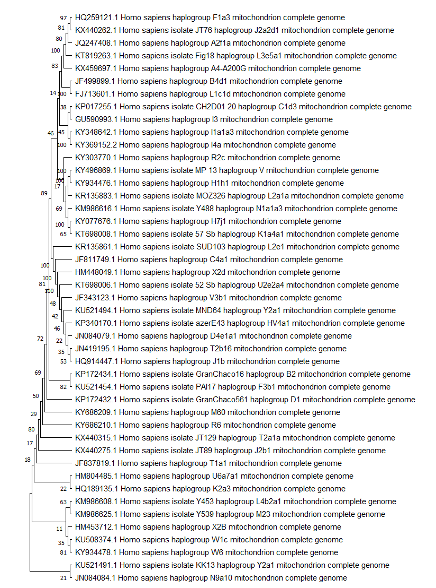
Neighbour Joining tree
; MEGA 11 (Molecular Evolutionary Genetics Analysis)
;
; Suggested Citation for MEGA 11:
;
; Tamura K, Stecher G, and Kumar S.
; MEGA11: Molecular Evolutionary Genetics Analysis version 11.
; Molecular Biology and Evolution (2021) 38:3022-3027
[Application Info]
Version = 11.0.13
Build = 11220624-x86_64
User Interface = Graphical
Operating System = windows
[General Info]
Data Type = nucleotide (non-coding)
No. of Taxa = 45
No. of Sites = 16576
Data File =
[Analysis Settings]
Scope = All Selected Taxa
Statistical Method = Neighbor-joining
Test of Phylogeny = Bootstrap method
No. of Bootstrap Replications = 500
Substitutions Type = Nucleotide
Model/Method = Maximum Composite Likelihood
Substitutions to Include = d: Transitions + Transversions
Rates among Sites = Uniform Rates
Pattern among Lineages = Same (Homogeneous)
Gaps/Missing Data Treatment = Pairwise deletion
Select Codon Positions = 1st,2nd,3rd,Non-Coding
Number of Threads = 8

Slide 5
Estimate the age of mitochondrial eve
Mutation Rate: Research suggests that the mutation rate for mtDNA in humans is roughly 1 mutation per 3,600 to 6,000 years. This rate is derived from trio sequencing (sequencing parents and offspring) as well as from ancient fossils. Some studies suggest a rate closer to 1 mutation every 3,000 to 4,000 years, but estimates can vary slightly based on methodologies.
Average Number of Mutations: Comparative studies indicate that the number of point mutations between modern humans and Mitochondrial Eve ranges from 75 to 150 mutations.
Conservative estimate (lower mutation rate): Age of Mitochondrial Eve=75 mutations×3,600 years/mutation=270,000 years
Upper estimate (higher mutation rate)=150 mutations×6,000 years/mutation=900,000 years
However, multiple studies and fossil data suggest a more reasonable range of 100,000 to 200,000 years, as noted. Based on these estimates and calibration with fossil evidence (like the 200,000-year-old Omo fossils), Mitochondrial Eve likely lived around 150,000 to 200,000 years ago.

Slide 6
Age of the most recent common ancestor of all non-africans
The most recent common ancestor of all non-africans is thought to have lived after modern humans began migrating out of Africa. The timing of this migration is generally estimated to be around 50,000 to 70,000 years ago, supported by genetic studies and fossil evidence. Studies on haplogroups suggest that the mtDNA lineages of non-Africans coalesce back to a single ancestor around 60,000 to 70,000 years ago, with estimates narrowing down to around 65,000 years based on population divergence modeling and genetic clocks.

Slide 7
Estimate the separation time and branching order of the Neanderthal and Denisovan population
Add Neanderthal mtDNA samples to a tree of modern human mtDNA haplogroups.
The split between modern humans and Neanderthals occurred approximately 400,000 to 600,000 years ago, with a molecular clock-based estimate pointing toward 600,000 years as a more likely scenario when calibrating with fossil evidence.

Slide 8
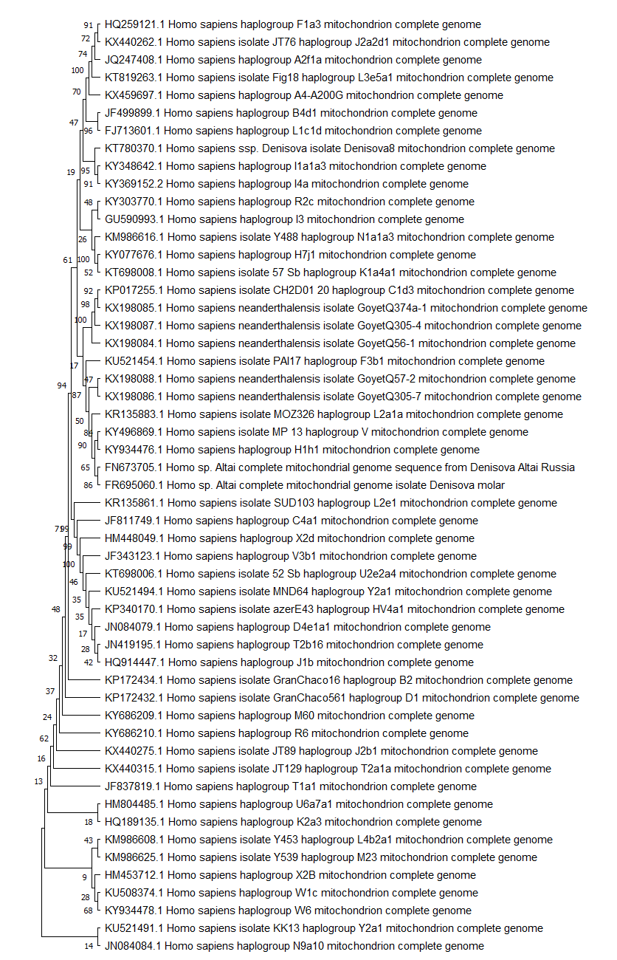
Image of the tree with the added mtDNA sample and determined haplogroup

Slide 9
Describe how humans have populated the Earth
Origins in Africa: Mitochondrial Eve and Early Human Populations (200,000 to 100,000 years ago)
Human Migrations Out of Africa (100,000 to 70,000 years ago)
Interaction with Neanderthals and Denisovans (50,000 to 40,000 years ago)
Expansion into Asia, Europe, and Oceania (60,000 to 40,000 years ago)
The Peopling of the Americas (15,000 to 20,000 years ago)
Post-Ice Age Population Movements (12,000 years ago to present)

